Slide 1
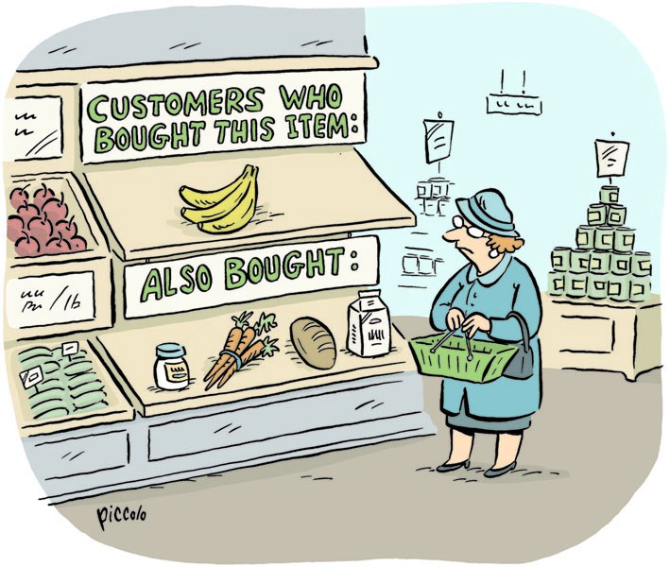
Finding Similar Items: Applications of Near-Neighbor Search
Presented By :- SNEHAL TAWAR

Slide 2
Contents:
Introduction
Jaccard Similarity Of Sets
Similarity of Documents
Collaborative Filtering as a Similar-Sets Problem
References

Slide 3

Introduction
A fundamental data-mining problem is to examine data for “similar” items.
Example: Looking at a collection of Web pages and finding near-duplicate pages. These pages could be plagiarisms, for example, or they could be mirrors that have almost the same content but differ in information about the host and about other mirrors.
We shall focus initially on a particular notion of “similarity”: the similarity of
sets by looking at the relative size of their intersection. This notion of similarity
is called “Jaccard similarity”.
We then examine some of the uses of finding similar sets. These include finding textually similar documents and collaborative filtering by finding similar customers and similar products.

Slide 4
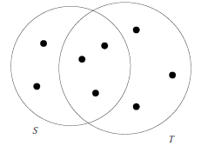
Jaccard Similarity of Sets
The Jaccard similarity of sets S and T is |S ∩ T |/|S ∪ T |, that is, the ratio of the size of the intersection of S and T to the size of their union. We shall denote the Jaccard similarity of S and T by SIM(S, T ).
Example 3.1 : In Figure below, we see two sets S and T . There are three elements
in their intersection and a total of eight elements that appear in S or T or both.
Thus, SIM(S, T ) = 3/8.
Two sets with Jaccard similarity 3/8

Slide 5


Similarity of Documents
We should understand that the aspect of similarity we are looking at here is character-level similarity, not “similar meaning,” which requires us to examine the words in the documents and their uses.
Textual similarity also has important uses. Many of these involve finding duplicates or near duplicates.
Testing whether two documents are exact duplicates is easy; just compare the two documents character-by-character, and if they ever differ then they are not the same. However, in many applications, the documents are not identical, yet they share large portions of their text. Here are some examples:
Plagiarism:
Finding plagiarized documents tests our ability to find textual similarity. The plagiarizer may extract only some parts of a document for his own. He may alter a few words and may alter the order in which sentences of the original appear. Yet the resulting document may still contain 50% or more of the original. No simple process of comparing documents character by character will detect a sophisticated plagiarism.

Slide 6

Mirror Pages:
It is common for important or popular Web sites to be duplicated at a number of hosts, in order to share the load. The pages of these mirror sites will be quite similar, but are rarely identical. For instance, they might each contain information associated with their particular host, and they might each have links to the other mirror sites but not to themselves. A related phenomenon is the appropriation of pages from one class to another. These pages might include class notes, assignments, and lecture slides. Similar pages might change the name of the course, year, and make small changes from year to year. It is important to be able to detect similar pages of these kinds, because search engines produce better results if they avoid showing two pages that are nearly identical within the first page of results.
Articles from the Same Source:
It is common for one reporter to write a news article that gets distributed, say through the Associated Press, to many newspapers, which then publish the article on their Web sites. Each newspaper changes the article somewhat. They may cut out paragraphs, or even add material of their own. They most likely will surround the article by their own logo, ads, and links to other articles at their site. However, the core of each newspaper’s page will be the original article. News aggregators, such as Google News, try to find all versions of such an article, in order to show only one, and that task requires finding when two Web pages are textually similar, although not identical.

Slide 7




Collaborative Filtering as a Similar-Sets Problem
Collaborative filtering is a process whereby we recommend to users items that were liked by other users who have exhibited similar tastes.
On-Line Purchases:-
Amazon.com has millions of customers and sells millions of items. Collaborative filtering requires several tools, in addition to finding similar customers or items, For example, two Amazon customers who like science-fiction might each buy many science-fiction books, but only a few of these will be in common. However, by combining similarity finding with clustering we might be able to discover that science fiction books are mutually similar and put them in one group. Then, we can get a more powerful notion of customer-similarity by asking whether they made purchases within many of the same groups.
Movie Ratings:-
When our data consists of ratings rather than binary decisions (bought/did not buy or liked/disliked), we cannot rely simply on sets as representations of customers or items. Some options are:
1. Ignore low-rated customer/movie pairs; that is, treat these events as if the customer never watched the movie.
2. When comparing customers, imagine two set elements for each movie, “liked” and “hated.” If a customer rated a movie highly, put the “liked” for that movie in the customer’s set.

Slide 8

If they gave a low rating to a movie, put “hated” for that movie in their set. Then, we can look for high Jaccard similarity among these sets. We can do a similar trick when comparing movies.
3. If ratings are 1-to-5-stars, put a movie in a customer’s set n times if they rated the movie n-stars. Then, use Jaccard similarity for bags when measuring the similarity of customers. The Jaccard similarity for bags B and C is defined by counting an element n times in the intersection if n is the minimum of the number of times the element appears in B and C. In the union, we count the element the sum of the number of times it appears in B and in C.
Example 3.2 :
The bag-similarity of bags {a, a, a, b} and {a, a, b, b, c} is 1/3.
The intersection counts a twice and b once, so its size is 3. The size of the union of two bags is always the sum of the sizes of the two bags, or 9 in this case.
Since the highest possible Jaccard similarity for bags is 1/2, the score of 1/3 indicates the two bags are quite similar, as should be apparent from an examination of their contents.

Slide 9
References:
https://towardsdatascience.com/comprehensive-guide-to-approximate-nearest-neighbors-algorithms-8b94f057d6b6
Mining of Massive Datasets, Anand Rajaraman and Jeffrey David Ullman, Cambridge University Press, 2012.

Slide 10
THANK YOU !

